Slide 1

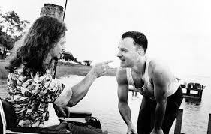
Limitations and future work
6
PART six

Slide 2
Data visualization
Features could be improved by add more informative sub features
For example: ‘Search trends’= ‘google trends’+’twitter heats’+’youtube search’
Feature engineering need more advanced techniques
For example: null value, category variables, scaling techniques
50%
70%
30%

Slide 3

Thank YOU

